Slide 1
MY DAILY LIFE
I am a student. A student must follow a definite mode of living. I pass my days according to certain rules and order. Of course, my daily life is nothing exceptional to interest one. I get up quite early in the morning. I have some morning walk. After taking my tiffin, I go to study at least for three hours.

Slide 2


Slide 3
In the morning
My daily routine is very simple. Every day I get up early in the morning at about 6 am. I brush my teeth and wash my hands and face. Then I got out for a walk in the open air and come back home after half an hour. Next, I have my breakfast. I do my homework till 9 am. Then I have my bath and put on my school uniform. My mother serves me a meal at 10 am.

Slide 4
In the afternoon
At about 10 a.m. I get up from my study. I have my bath and lunch and start for school at 10.30 a.m. After school hours I return punctually. After taking my tiffin, I go to play for an hour or two. My evening study starts at 7 p.m. After my Dinner, I regularly go to bed at 10 p.m

Slide 5
At night
Getting back, I take a thorough wash after which I sit at my lessons for the next day. At 10.30 p.m usually I sit with TV. I normally go to sleep at 11 p.m. This is what I call my daily routine for weekdays. On holidays I enjoy a family outing.

Slide 6
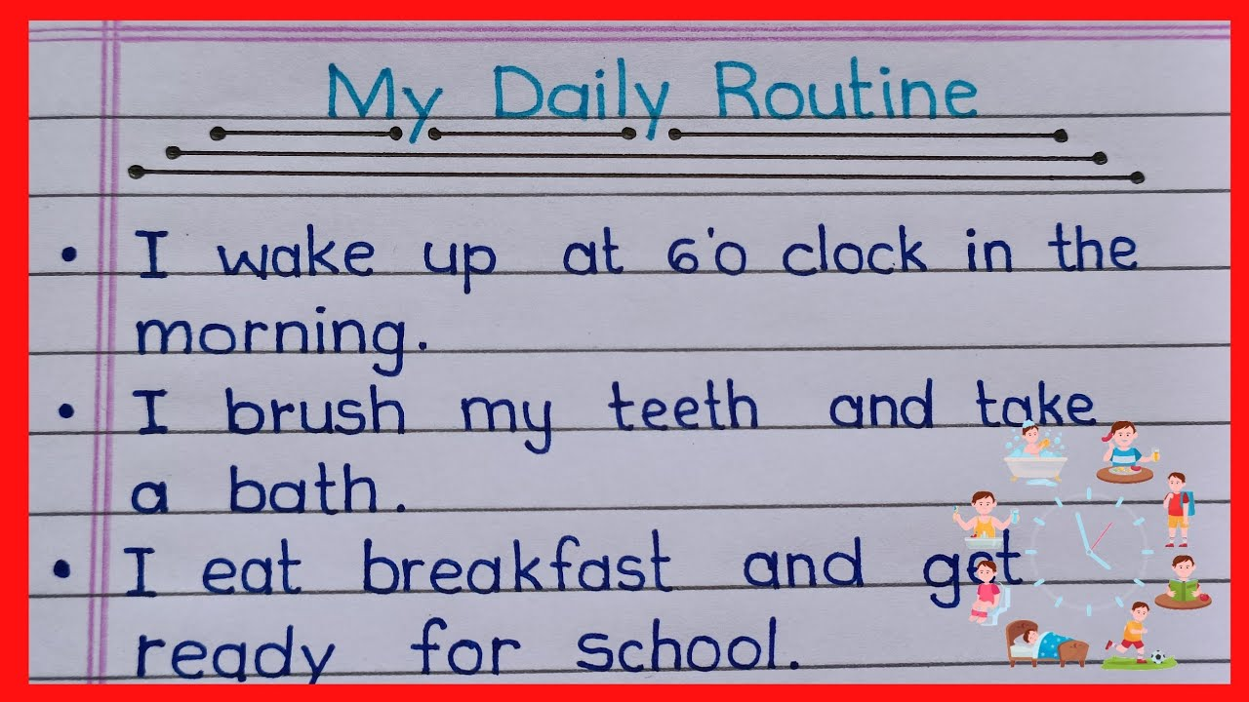
Importance of daily routine
Every day brings a new opportunity to make the most of our time. Having a daily routine is a well-structured plan that helps us stay organized, productive, and balanced. It ensures that we can juggle our responsibilities efficiently while finding moments of relaxation and self-care. A daily routine of a student revolves around various activities. Mornings kick off with an early rise, followed by preparing for school and having breakfast. Once at school, they engage in lessons across diverse subjects like math, science, and history. Post-school hours are filled with a mix of homework, participation in extracurriculars such as sports or clubs, and essential breaks for meals and relaxation. Evenings are dedicated to study sessions, completing any pending assignments, and winding down before bedtime. This routine forms the backbone of a student’s everyday life, balancing learning, activities, and moments of rest. In this blog, we will walk you through “my daily routine”, which spans from early morning rituals to bedtime habits, highlighting the key activities that keep us on track and help us achieve my goals.

Slide 7
THANK YOU

